Slide 1

ONLINE FLIGHT RESERVATION SYSTEM
B.POOJA(192211757)
U.SUJALA REDDY(192211737)
D.SAI CHARMITHA(192211761)
B.MEGHANA(192211562)

Slide 2

INTRODUCTION
An online flight reservation system is a digital platform that enables users to search for, book, and manage flight tickets via the internet.
Online flight reservation systems have transformed the way we travel, making it easier and more efficient to plan journeys.

Slide 3

User-Friendly Interface:
A user-friendly interface is critical for seamless navigation and intuitive interaction. Clear design elements, logical flow, and accessible features ensure a positive user experience.
Intuitive Navigation
Clear menus, easily accessible search functions, and simple booking processes ensure a hassle-free user experience.
Visual Appeal
A visually appealing interface with a modern design and intuitive layout enhances user engagement and satisfaction.
Responsive Design
Adaptability to various devices and screen sizes guarantees optimal user experience across platforms.

Slide 4
HOME PAGE
User registration and login are essential for personalized experiences and managing user data. Secure authentication methods ensure safe access to account information.
Registration
A simple registration process with easy-to-understand fields ensures a smooth onboarding experience.
Verification emails and password strength requirements enhance security and prevent unauthorized access.
Login
Secure login procedures, including password encryption and two-factor authentication, protect user accounts and sensitive information.
Remember me options allow for convenient access without repeated logins, enhancing the user experience.

Slide 5
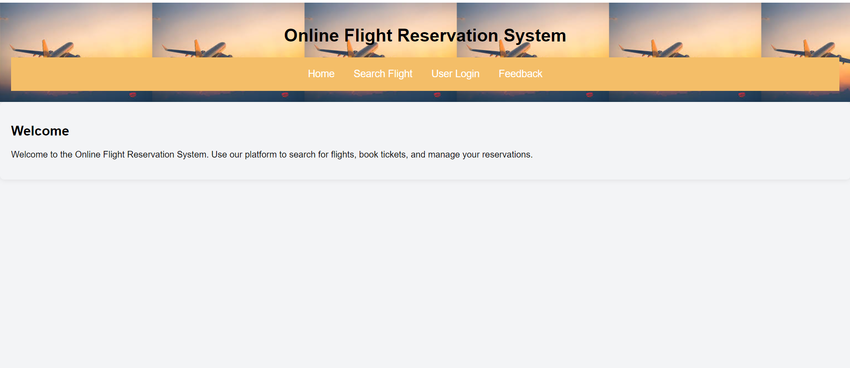
HOME PAGE:

Slide 6
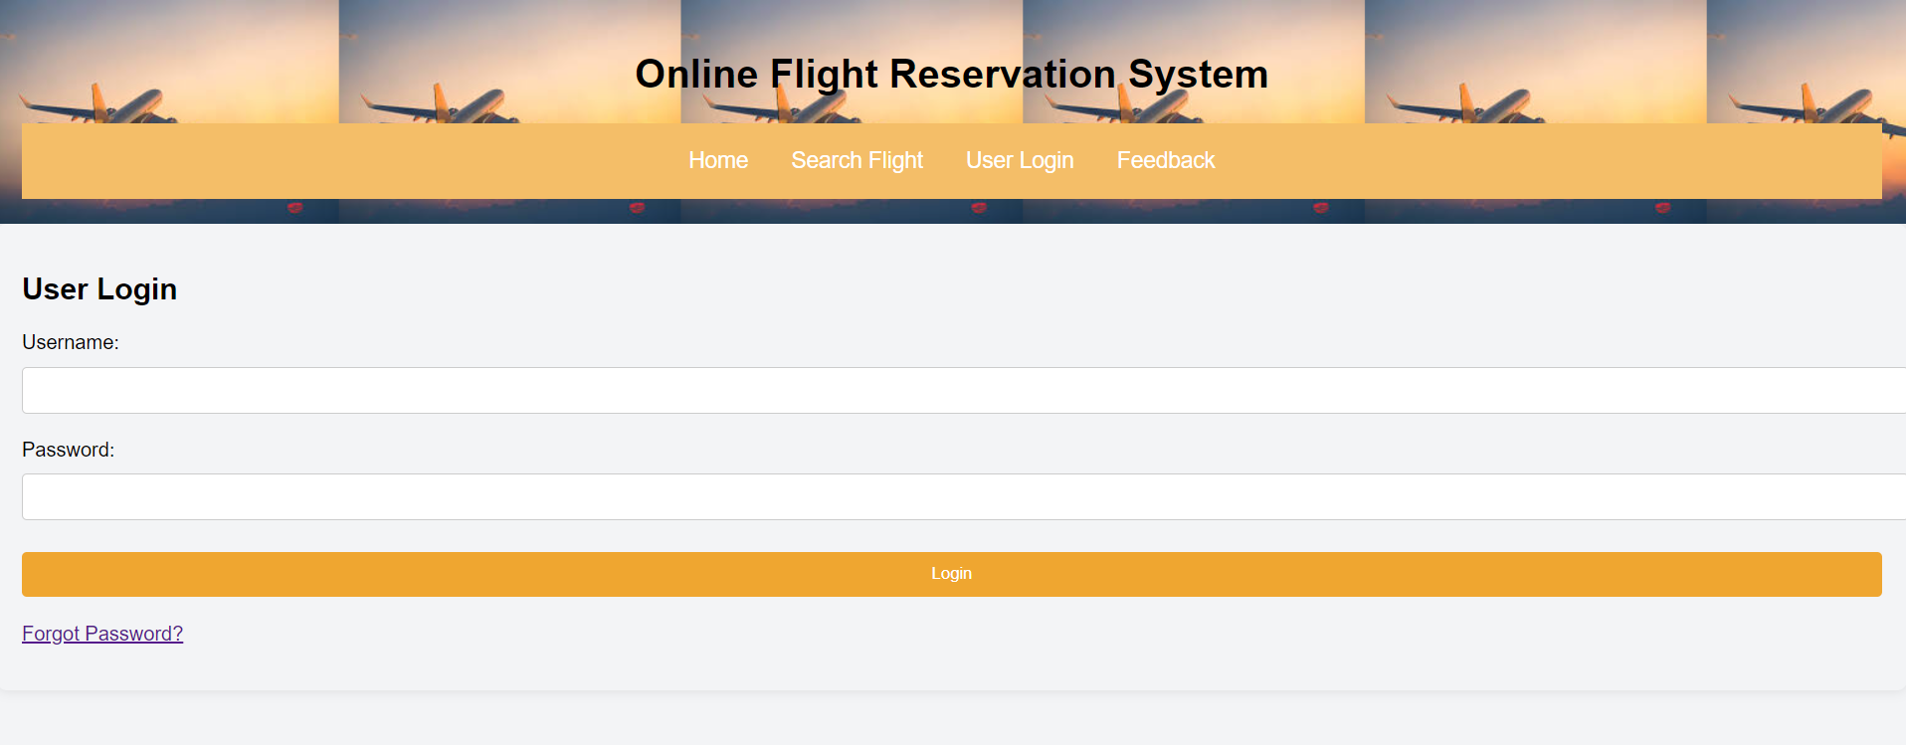
USER LOGIN:

Slide 7
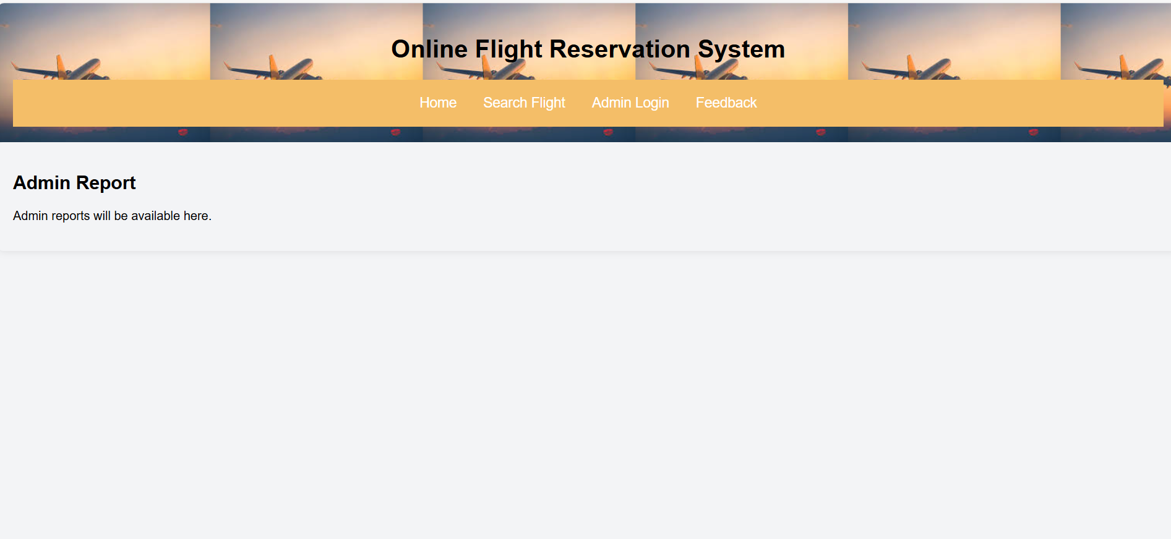
ADMIN REPORTS PAGE:

Slide 8
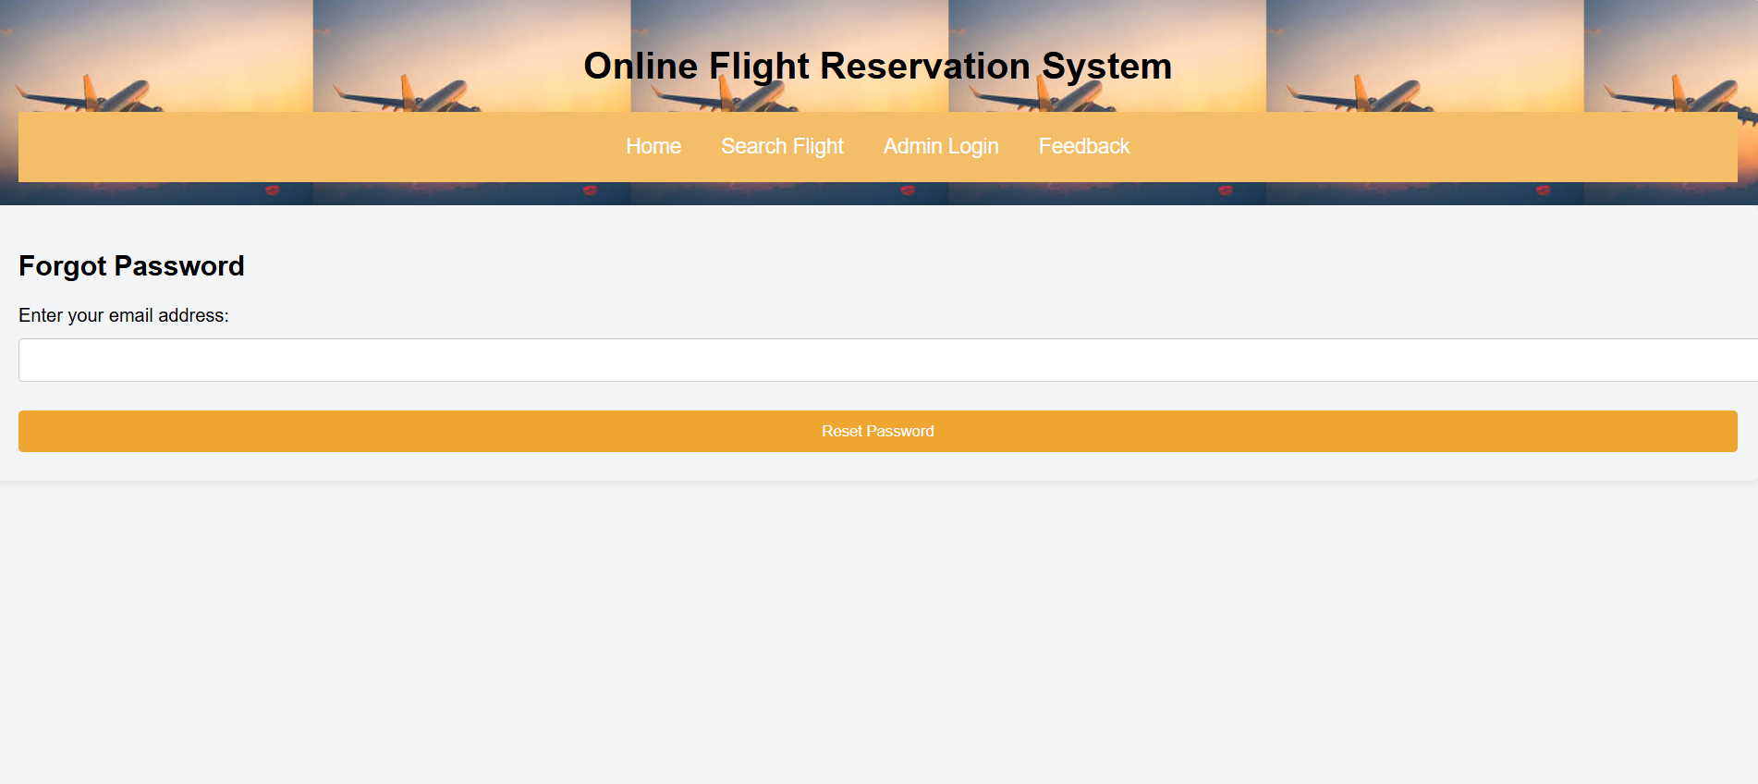
FORGOT PASSWORD PAGE:

Slide 9

Reservation
The booking process is the core of the system, allowing users to search, select, and reserve flights with ease.
1.Flight Search
Users can search for flights based on origin, destination, dates, and other criteria.
2.Flight Selection
Users can compare flight options, prices, and airlines to choose the best fit.
3.Reservation
Users can select their desired flights, choose seats, and proceed to payment.

Slide 10
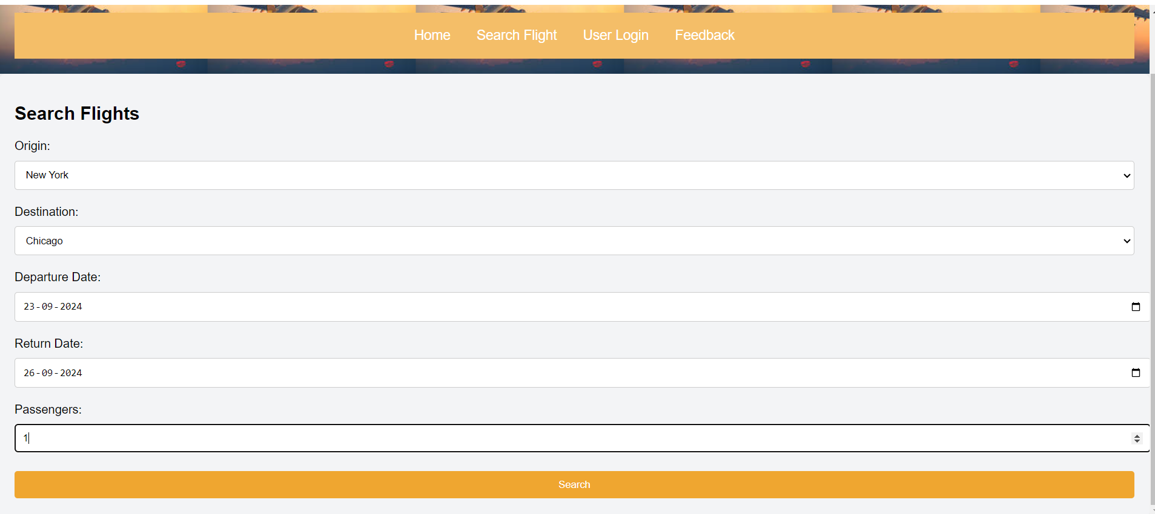
SEARCH FLIGHTS PAGE:

Slide 11

Passenger Information Management
Managing passenger information is essential for accurate ticketing, travel arrangements, and communication.
Personal Information
Name, Date of Birth, Address, Phone Number, Email Address
Travel History
Previous bookings, frequent flyer details, loyalty program information, travel preferences
Emergency Contact
Name, Phone Number, Relationship to passenger

Slide 12
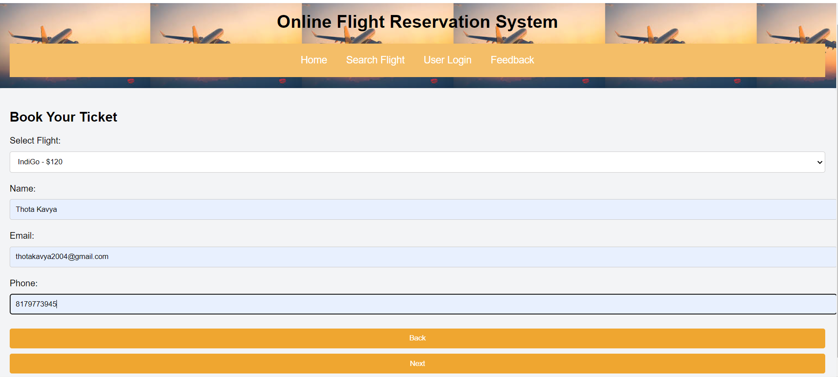
BOOK TICKET PAGE:

Slide 13
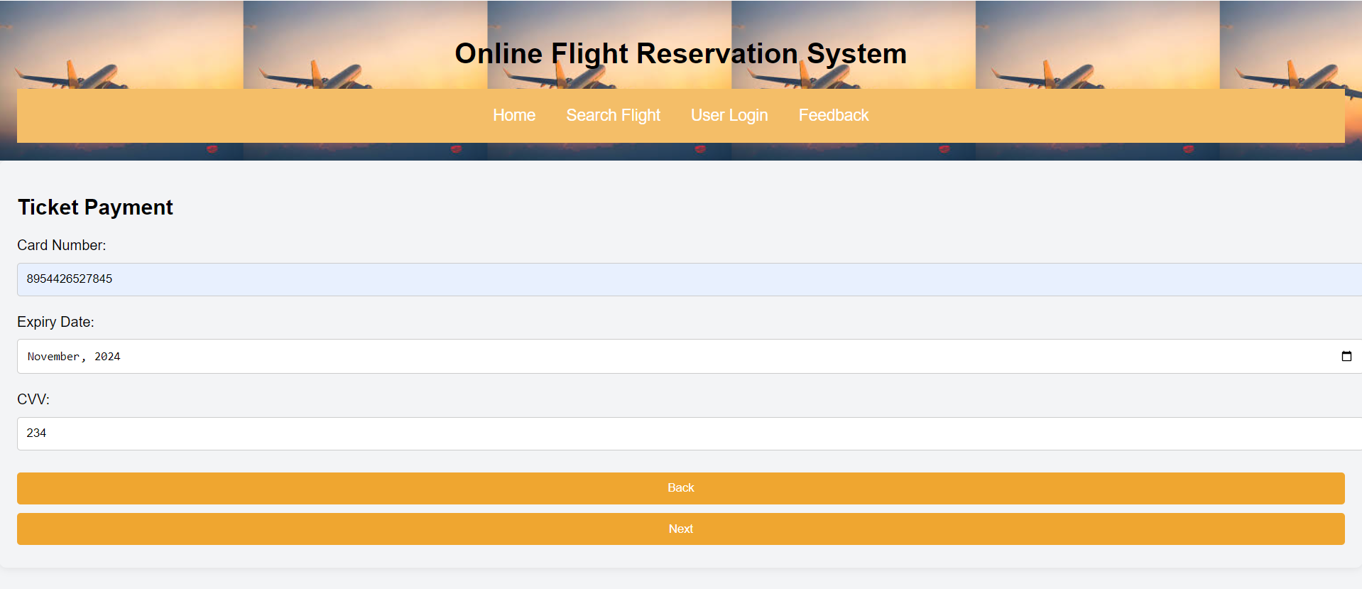
TICKET PAYMENT PAGE:

Slide 14
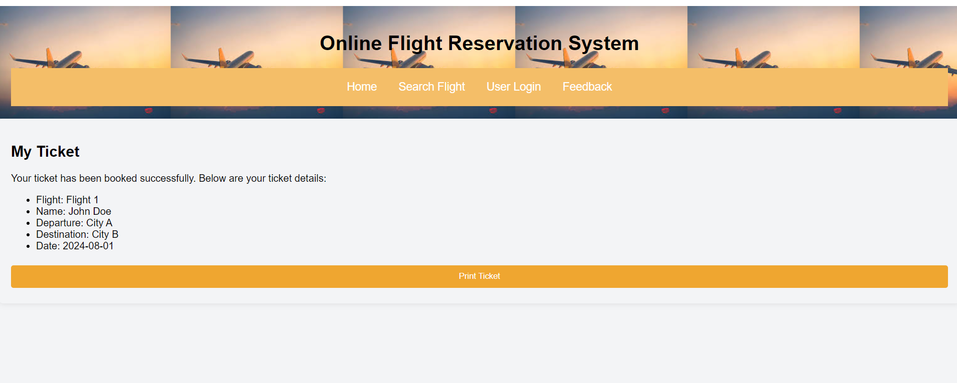
MY TICKET PAGE:

Slide 15
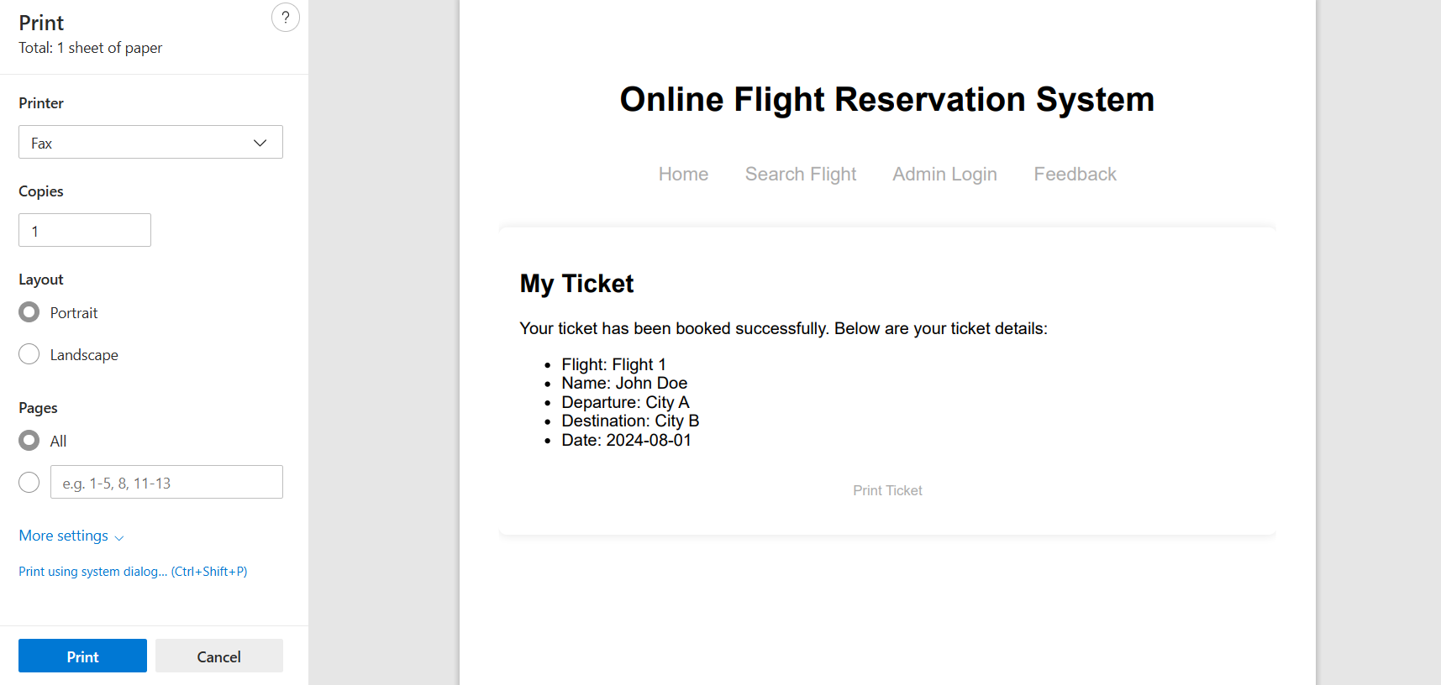
PRINT TICKET PAGE:

Slide 16
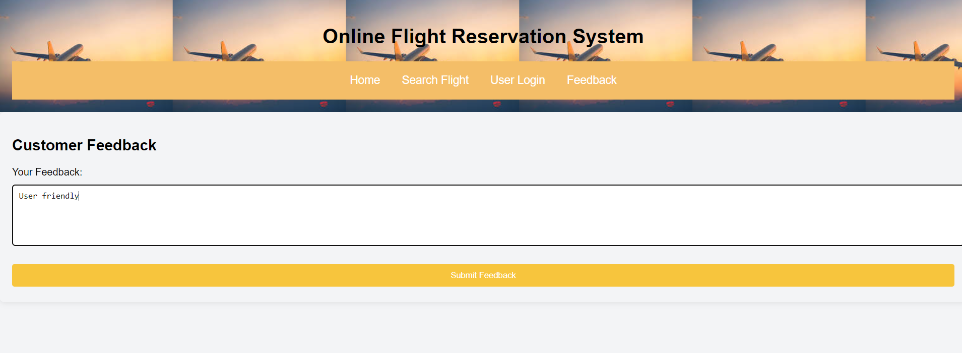
CUSTOMER FEEDBACK PAGE:

Slide 17

CONCLUSION
In summary, online flight reservation systems have fundamentally changed the landscape of air travel by providing convenience, efficiency, and greater accessibility to travelers worldwide.
With features like real-time availability, secure payment processing, and user-friendly interfaces, these systems empower passengers to take control of their travel plans.
As technology advances, we can expect even more innovative functionalities that will enhance user experiences and streamline the booking process.

Slide 18


